Slide 1
22CS304 – Operating Systems
UNIT I INTRODUCTION TO OPERATING SYSTEMS AND PROCESSES
Introduction to OS –Computer system organization - architecture – Resource management - Protection and Security – Virtualization - Operating System Structures - Services - User and Operating-System Interface - System Calls - System Services - Design and Implementation - Building and Booting an Operating System - Process Concept - Process Scheduling - Operations on Processes – Inter process Communication - IPC in Shared-Memory Systems - IPC in Message-Passing Systems
UNIT II THREADS AND CPU SCHEDULING
Threads & Concurrency: Overview - Multicore Programming - Multithreading Models - Thread Libraries - Implicit Threading - Threading Issues - CPU Scheduling: Basic Concepts - Scheduling Criteria - Scheduling Algorithms - Thread Scheduling - Multi- Processor Scheduling - Real-Time CPU Scheduling
UNIT III PROCESS SYNCHRONISATION AND DEADLOCKS
Process Synchronization - The critical-section problem, Peterson’s Solution - Synchronization hardware, Mutex locks, Semaphores, monitors, Liveness - Classic problems of synchronization – Bounded Buffer Problem - Reader’s & Writer Problem, Dinning Philosopher Problem, Barber’s shop problem. Deadlock - System model - Deadlock characterization, Methods for handling deadlocks - Deadlock prevention - Deadlock avoidance - Deadlock detection - Recovery from deadlock
UNIT IV MEMORY MANAGEMENT
Memory Management: Contiguous Memory Allocation - Paging - Structure of the Page Table – Swapping - Virtual Memory: Demand Paging – Copy-on write – Page Replacement – Allocation of frames – Thrashing Memory – Compression
UNIT V FILE MANAGEMENT
File Management: File Concept – Access Methods – Directory Structure – Protection - Memory-Mapped File - Disk Management: Disk structure, Disk scheduling - FCFS, SSTF, SCAN, C-SCAN, Disk reliability, Disk formatting, Boot-block, Bad blocks - I/O Hardware: I/O devices, Device controllers, Direct Memory Access - Case Study-Linux.

Slide 2
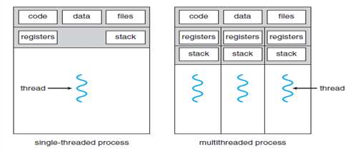
Unit II - THREADS AND CPU SCHEDULING
Threads & Concurrency: Overview
A thread is a basic unit of CPU utilization
It comprises a thread ID, a program counter (PC), a register set, and a stack.
It shares with other threads belonging to the same process its code section, data section, and other operating-system resources, such as open files and signals.
A traditional (or heavyweight) process has a single thread of control.
If a process has multiple threads of control, it can perform more than one task at a time.
Figure illustrates the difference between a traditional single-threaded process and a multithreaded

Slide 3
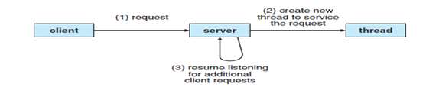
Unit II - THREADS AND CPU SCHEDULING
Threads & Concurrency: Overview
Ex: A web server accepts client requests for web pages, images, sound, and so forth.
A busy web server may have several clients concurrently accessing it.
If the web server ran as a traditional single-threaded process
it would be able to service only one client at a time, and a client might have to wait a very long time for its request to be serviced.
If the web-server process is multithreaded
the server will create a separate thread that listens for client requests.
When a request is made
rather than creating another process, the server creates a new thread to service the request and resume listening for additional requests.

Slide 4
Unit II - THREADS AND CPU SCHEDULING
Threads & Concurrency: Overview
The benefits of multithreaded programming can be broken down into four major categories:
Responsiveness
Multithreading an interactive application
Allow a program to continue running even if part of it is blocked or
Performing a lengthy operation, thereby increasing responsiveness to the user
2. Resource sharing
Threads share the memory and the resources of the process to which they belong by default
The benefit of sharing code and data is that it allows an application to have several different threads of activity within the same address space
3. Economy
Threads share the resources of the process to which they belong, it is more economical to create and context-switch threads
Additionally, context switching is typically faster between threads than between processes
4. Scalability
The benefits of multithreading can be even greater in a multiprocessor architecture, where threads may be running in parallel on different processing cores

Slide 5
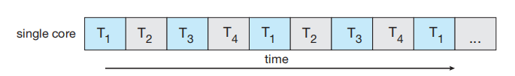
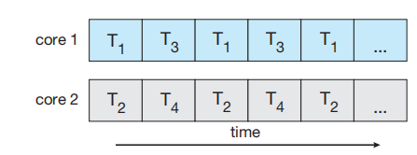
Unit II - THREADS AND CPU SCHEDULING
Mutlicore Programming
Multicore is the system design is to place multiple computing cores on a single processing chip where each core appears as a separate CPU to the operating system.
Multicore and multithreaded programming provides a mechanism for more efficient use of these multiple computing cores and improved concurrency.
Consider an application with four threads. On a system with a single computing core, concurrency merely means that the execution of the threads will be interleaved over time, because the processing core is capable of executing only one thread at a time
On a system with multiple cores, however, concurrency means that some threads can run in parallel, because the system can assign a separate thread to each core

Slide 6
Unit II - THREADS AND CPU SCHEDULING
Mutlicore Programming
A concurrent system supports more than one task by allowing all the tasks to make progress.
Thus, it is possible to have concurrency without parallelism.
Before the advent of multiprocessor and multicore architectures, most computer systems had only a single processor
CPU schedulers were designed to provide the illusion of parallelism by rapidly switching between processes
Thereby allowing each process to make progress. Such processes were running concurrently, but not in parallel.
Types of Parallelism
There are two types of parallelism: data parallelism and task parallelism.
Data parallelism
focuses on distributing subsets of the same data across multiple computing cores and performing the same operation on each core.
Consider, for example, summing the contents of an array of size N. On a single-core system, one thread would simply sum the elements [0] ...[N − 1].

Slide 7
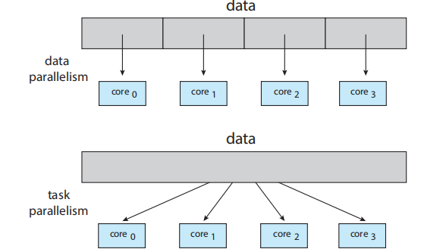
Unit II - THREADS AND CPU SCHEDULING
Mutlicore Programming
On a dual-core system, however, thread A, running on core 0, could sum the elements [0] . . . [N∕2 − 1]
while thread B, running on core 1, could sum the elements [N∕2] . . . [N − 1].
The two threads would be running in parallel on separate computing cores.
Task parallelism
Distributing not data but tasks (threads) across multiple computing cores
Each thread is performing a unique operation
Different threads may be operating on the same data, or they may be operating on different data
Data parallelism involves the distribution of data across multiple cores, and task parallelism involves the distribution of tasks across multiple cores

Slide 8
Unit II - THREADS AND CPU SCHEDULING
Mutlicore Programming
Programming Challenges in multicore systems
Identifying tasks. Examining applications to find areas that can be divided into separate, concurrent tasks.
Ideally, tasks are independent of one another and thus can run in parallel on individual cores.
Balance. While identifying tasks that can run in parallel, programmers must also ensure that the tasks perform equal work of equal value.
Data splitting. Just as applications are divided into separate tasks, the data accessed and manipulated by the tasks must be divided to run on separate cores.
Data dependency. The data accessed by the tasks must be examined for dependencies between two or more tasks. When one task depends on data from another, programmers must ensure that the execution of the tasks is synchronized to accommodate the data dependency.
Testing and debugging. When a program is running in parallel on multi_x0002_ple cores, many different execution paths are possible. Testing and debugging such concurrent programs is inherently more difficult than testing and debugging single-threaded applications.

Slide 9
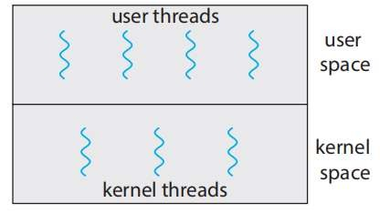
Unit II - THREADS AND CPU SCHEDULING
Mutlithreading Models
Threads may be provided either at the user level, for user threads, or by the kernel, for kernel threads.
User threads are supported above the kernel and are managed without kernel support.
Kernel threads are supported and managed directly by the operating system.
Virtually all contemporary operating systems—including Windows, Linux, and macOS— support kernel threads. Ultimately, a relationship must exist between user threads and kernel threads
User and Kernel threads

Slide 10
Unit II - THREADS AND CPU SCHEDULING
Mutlithreading Models
Many-to-One Model
The many-to-one model maps many user-level threads to one kernel thread.
Thread management is done by the thread library in user space, so it is efficient.
However, the entire process will block if a thread makes a blocking system call.
Also, because only one thread can access the kernel at a time, multiple threads are unable to run in parallel on multicore systems.

Slide 11
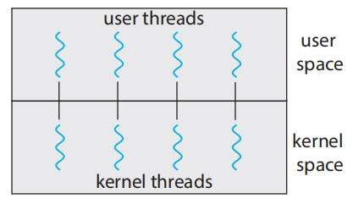
Unit II - THREADS AND CPU SCHEDULING
Mutlithreading Models
2. One-to-One Model
The one-to-one model maps each user thread to a kernel thread.
It provides more concurrency than the many-to-one model by allowing another thread to run when a thread makes a blocking system call.
It also allows multiple threads to run in parallel on multiprocessors.
The only drawback to this model is that creating a user thread requires creating the corresponding kernel thread

Slide 12
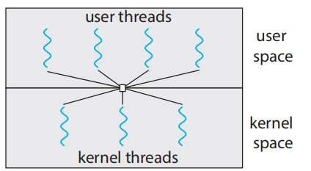
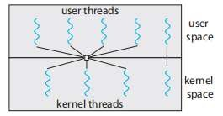
Unit II - THREADS AND CPU SCHEDULING
Mutlithreading Models
3. Many-to-Many Model
The many-to-many model multiplexes many user-level threads to a smaller or equal number of kernel threads
The number of kernel threads may be specific to either a particular application or a particular machine
One variation on the many-to-many model still multiplexes many user_x0002_level threads to a smaller or equal number of kernel threads but also allows a user-level thread to be bound to a kernel thread. This variation is sometimes referred to as the two-level model
Many to many model Two level model

Slide 13
Unit II - THREADS AND CPU SCHEDULING
Thread Libraries
A thread library provides the programmer with an API for creating and managing threads.
There are two primary ways of implementing a thread library.
The first approach is to provide a library entirely in user space with no kernel support.
All code and data structures for the library exist in user space.
This means that invoking a function in the library results in a local function call in user space and not a system call.
The second approach is to implement a kernel-level library supported directly by the operating system.
In this case, code and data structures for the library exist in kernel space. Invoking a function in the API for the library typically results in a system call to the kernel.
Three main thread libraries are in use today: POSIX Pthreads, Windows, and Java.
Pthreads, the threads extension of the POSIX standard, may be provided as either a user-level or a kernel-level library.
The Windows thread library is a kernel-level library available on Windows systems.
The Java thread API allows threads to be created and managed directly in Java programs.

Slide 14
Unit II - THREADS AND CPU SCHEDULING
Thread Libraries
There are two general strategies for creating multiple threads
Asynchronous threading
Synchronous threading
Asynchronous threading
once the parent creates a child thread, the parent resumes its execution, so that the parent and child execute concurrently and independently of one another
Synchronous threading
Synchronous threading occurs when the parent thread creates one or more children and then must wait for all of its children to terminate before it resumes

Slide 15
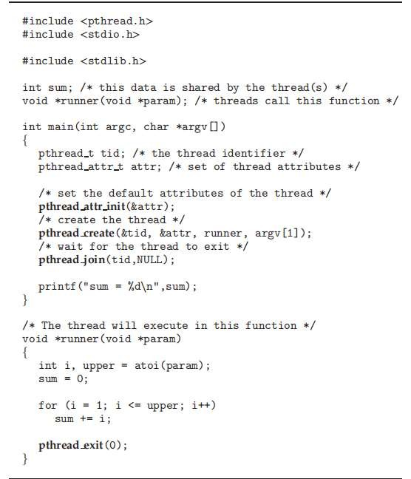
Unit II - THREADS AND CPU SCHEDULING
Thread Libraries
Pthreads refers to the POSIX standard (IEEE 1003.1c) defining an API for thread creation and synchronization.
Operating-system designers may implement the specification in any way they wish.
Numerous systems implement the Pthreads specification; most are UNIX-type systems, including support Pthreads natively, some available

Slide 16
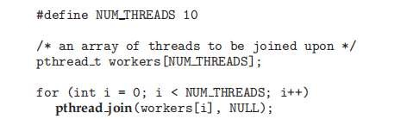
Unit II - THREADS AND CPU SCHEDULING
Thread Libraries
Pthreads API for constructing a multithreaded program that calculates the summation of a non-negative integer in a separate thread.
In a Pthreads program, separate threads begin execution in a specified function.
When this program begins, a single thread of control begins in main().
After some initialization, main() creates a second thread that begins control in the runner() function. Both threads share the global data sum.
A simple method for waiting on several threads using the pthread join() function is to enclose the operation within a simple for loop.

Slide 17
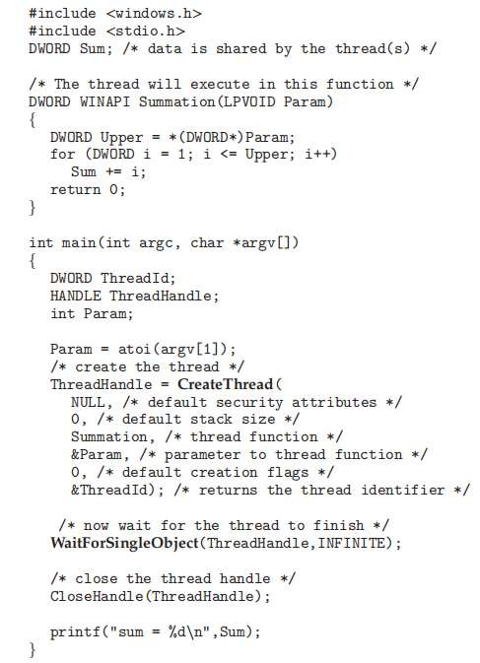
Unit II - THREADS AND CPU SCHEDULING
Thread Libraries
Windows Thread
The technique for creating threads using the Windows thread library is similar to the Pthreads technique in several ways. Notice that we must include the windows.h header file when using the Windows API.

Slide 18
Unit II - THREADS AND CPU SCHEDULING
Thread Libraries
Threads are created in the Windows API using the CreateThread() function,
Once the summation thread is created, the parent must wait for it to complete before outputting the value of Sum, as the value is set by the summation thread.
In the Windows API WaitForSingleObject() function causes the creating thread to block until the summation thread has exited.
In situations that require waiting for multiple threads to complete, the WaitForMultipleObjects() function is used. This function is passed four parameters:
The number of objects to wait for
A pointer to the array of objects
A flag indicating whether all objects have been signaled
A timeout duration (or INFINITE)
For example, if THandles is an array of thread HANDLE objects of size N, the parent thread can wait for all its child threads to complete with this statement:
WaitForMultipleObjects(N, THandles, TRUE, INFINITE);

Slide 19
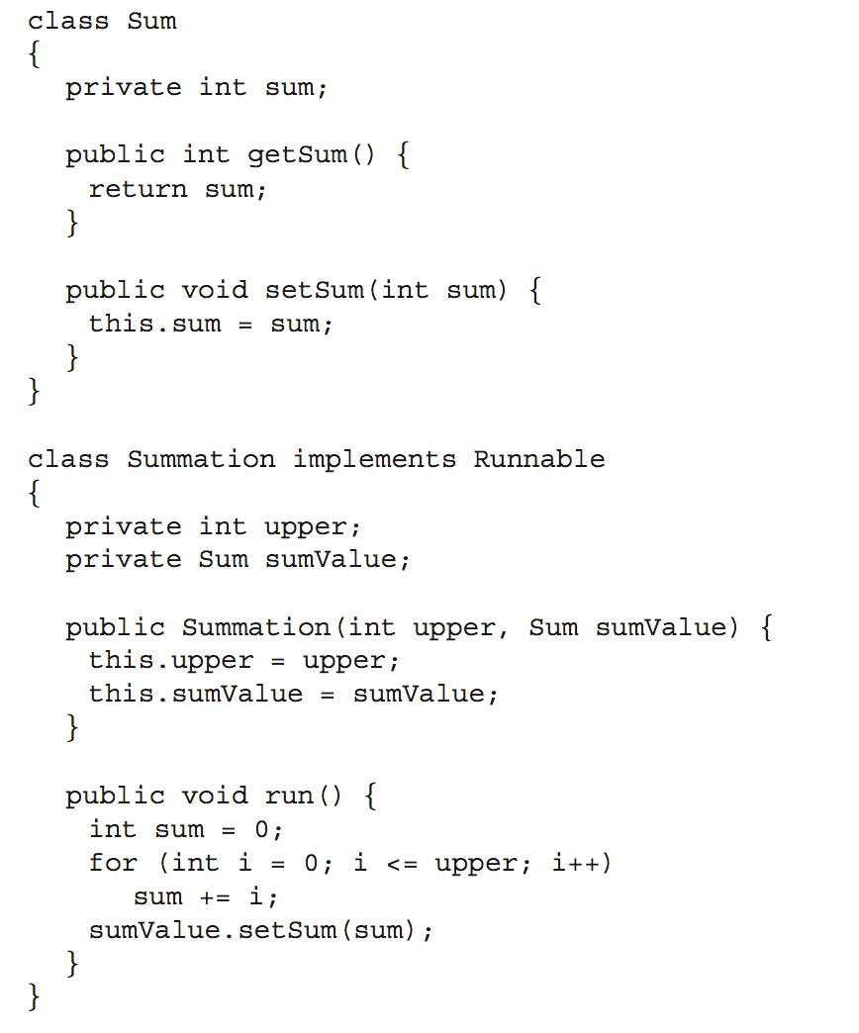
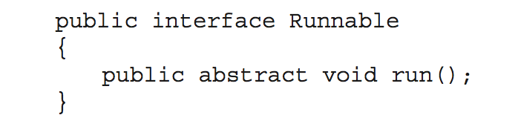
Unit II - THREADS AND CPU SCHEDULING
Thread Libraries
Java Threads
Java threads are managed by the JVM
Typically implemented using the threads model provided by underlying OS
Java threads may be created by:
Extending Thread class
Implementing the Runnable interface

Slide 20
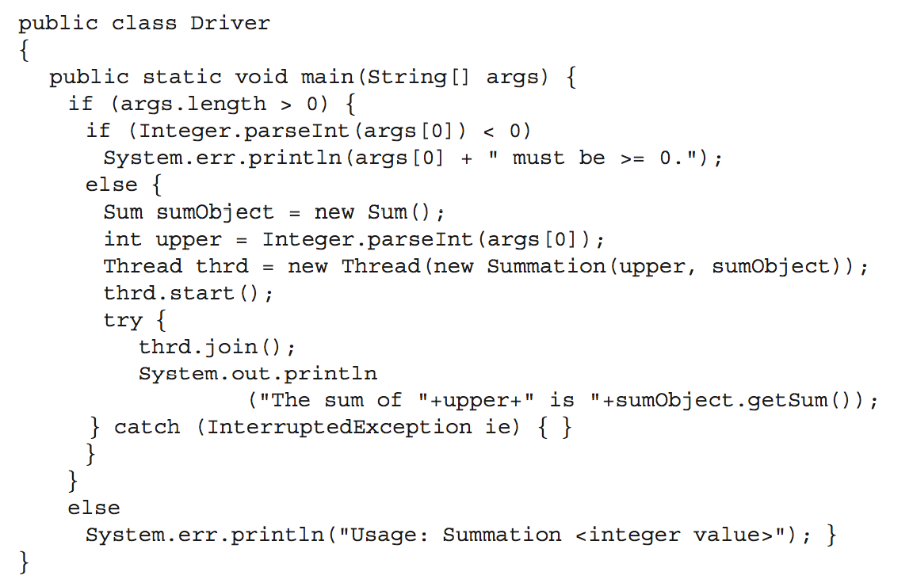
Unit II - THREADS AND CPU SCHEDULING
Thread Libraries

Slide 21
Unit II - THREADS AND CPU SCHEDULING
Implicit Threading
Growing in popularity as numbers of threads increase, program correctness more difficult with explicit threads
Creation and management of threads done by compilers and run-time libraries rather than programmers
Three methods explored
Thread Pools
OpenMP
Grand Central Dispatch
Other methods include Microsoft Threading Building Blocks (TBB), java.util.concurrent package

Slide 22
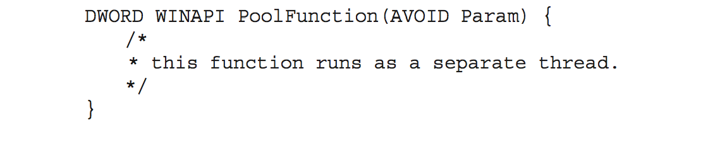
Unit II - THREADS AND CPU SCHEDULING
Implicit Threading
Thread Pools
Create a number of threads in a pool where they await work
Advantages:
Usually slightly faster to service a request with an existing thread than create a new thread
Allows the number of threads in the application(s) to be bound to the size of the pool
Separating task to be performed from mechanics of creating task allows different strategies for running task
i.e. Tasks could be scheduled to run periodically
Windows API supports thread pools:

Slide 23
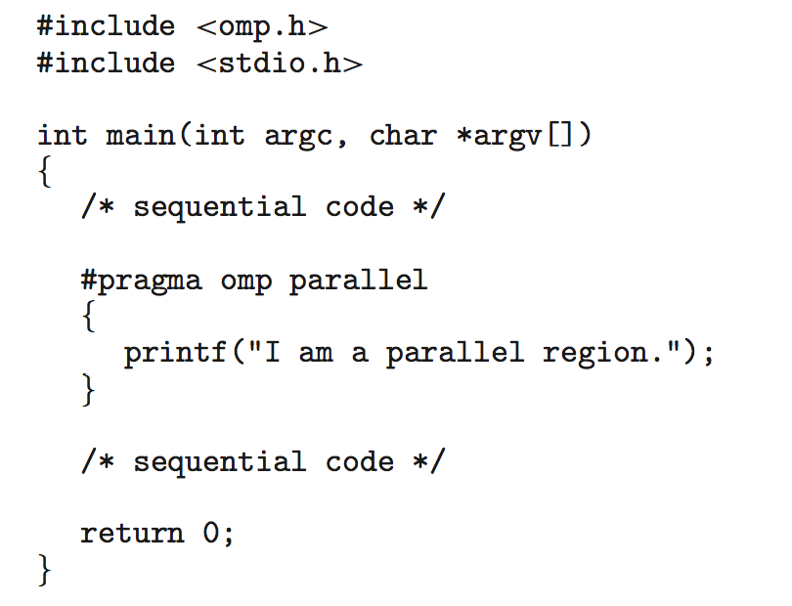
Unit II - THREADS AND CPU SCHEDULING
Implicit Threading
OpenMP
Set of compiler directives and an API for C, C++, FORTRAN
Provides support for parallel programming in shared-memory environments
Identifies parallel regions – blocks of code that can run in parallel
#pragma omp parallel
Create as many threads as there are cores
#pragma omp parallel for for(i=0;i<N;i++) {
c[i] = a[i] + b[i];
}
Run for loop in parallel

Slide 24
Unit II - THREADS AND CPU SCHEDULING
Implicit Threading
Grand Central Dispatch
Technology developed by Apple for its macOS and iOS operating systems.
It is a combination of a run-time library, an API, and language extensions that allow developers to identify sections of code (tasks) to run in parallel.
GCD schedules tasks for run-time execution by placing them on a dispatch queue
When it removes a task from a queue
it assigns the task to an available thread from a pool of threads that it manages.
GCD identifies two types of dispatch queues: serial and concurrent.
Tasks placed on a serial queue are removed in FIFO order. Once a task has been removed from the queue, it must complete execution before another task is removed.
Tasks placed on a concurrent queue are also removed in FIFO order, but several tasks may be removed at a time, thus allowing multiple tasks to execute in parallel.

Slide 25
Unit II - THREADS AND CPU SCHEDULING
Threading Issues
Thread Cancellation
Thread cancellation involves terminating a thread before it has completed.
Example:
If multiple threads are concurrently searching through a database and one thread returns the result, the remaining threads might be cancelled.
Another situation might occur when a user presses a button on a web browser that stops a web page from loading any further.
Often, a web page loads using several threads—each image is loaded in a separate thread. When a user presses the stop button on the browser, all threads loading the page are cancelled.
A thread that is to be cancelled is often referred to as the target thread.
Cancellation of a target thread may occur in two different scenarios:
Asynchronous cancellation. One thread immediately terminates the target thread.
Deferred cancellation. The target thread periodically checks whether it should terminate, allowing it an opportunity to terminate itself in an orderly fashion.

Slide 26
Unit II - THREADS AND CPU SCHEDULING
Implicit Threading
Thread Cancellation
The default cancellation type is deferred cancellation.
However, cancellation occurs only when a thread reaches a cancellation point.
Most of the blocking system calls in the POSIX and standard C library are defined as cancellation points, and these are listed when invoking the command man pthreads on a Linux system.
Pthreads allows a function known as a cleanup handler to be invoked if a thread is canceled.
This function allows any resources a thread may have acquired to be released before the thread is terminated.

Slide 27
Unit II - THREADS AND CPU SCHEDULING
Implicit Threading
THREAD STORAGE
Threads belonging to a process share the data of the process.
Data sharing provides one of the benefits of Multithreaded Programming.
Some circumstances, each thread might need its own copy of certain data, such data thread-local storage (or TLS). Example, in a transaction-processing system,
Service each transaction in a separate thread.
Each transaction might be assigned a unique identifier.
To associate each thread with its unique transaction identifier, use thread-local storage.
Different from local variables
Local variables visible only during single function invocation
TLS visible across function invocations

Slide 28
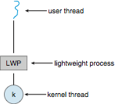
Unit II - THREADS AND CPU SCHEDULING
Implicit Threading
SCHEDULER ACTIVATIONS
Both Many-many and Two-level models require communication to maintain the appropriate number of kernel threads allocated to the application
Typically use an intermediate data structure between user and kernel threads – lightweight process (LWP)
Appears to be a virtual processor on which process can schedule user thread to run
Each LWP attached to kernel thread
Scheduler activations provide upcalls - a communication mechanism from the kernel to the upcall handler in the thread library
This communication allows an application to maintain the correct number kernel threads

Slide 29
Unit II - THREADS AND CPU SCHEDULING
CPU SCHEDULER – BASIC CONCEPTS
Maximum CPU utilization obtained with multiprogramming
CPU–I/O Burst Cycle – Process execution consists of a cycle of CPU execution and I/O wait
CPU burst followed by I/O burst
CPU burst distribution is of main concern

Slide 30
Unit II - THREADS AND CPU SCHEDULING
CPU SCHEDULER – BASIC CONCEPTS
Short-term scheduler selects from among the processes in ready queue, and allocates the CPU to one of them
Queue may be ordered in various ways
CPU scheduling decisions may take place when a process:
1. Switches from running to waiting state
2. Switches from running to ready state
3. Switches from waiting to ready
4. Terminates
Scheduling under 1 and 4 is nonpreemptive : Once the CPU has been allocated to a process, the process keeps the CPU until it releases the CPU either by terminating or by switching to the waiting state.
All other scheduling is preemptive : the ability of the operating system to preempt (that is, stop or pause) a currently scheduled process in favour of a higher priority process.

Slide 31
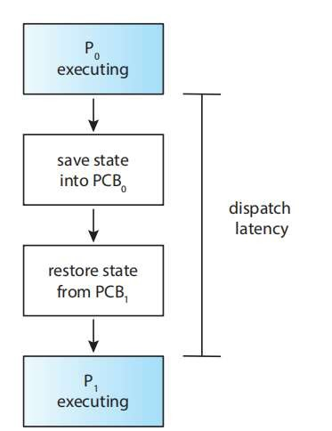
Unit II - THREADS AND CPU SCHEDULING
CPU SCHEDULER – BASIC CONCEPTS
The dispatcher is the module that gives control of the CPU’s core to the process selected by the CPU scheduler.
This function involves the following:
Switching context from one process to another
Switching to user mode
Jumping to the proper location in the user program to resume that program
The dispatcher should be as fast as possible, since it is invoked during every context switch. The time it takes for the dispatcher to stop one process and start another running is known as the dispatch latency.

Slide 32
Unit II - THREADS AND CPU SCHEDULING
SCHEDULING CRITERIA
Many criteria have been suggested for comparing CPU-scheduling algorithms. The criteria include the following:
CPU utilization. To keep the CPU as busy as possible. Conceptually, CPU utilization can range from 0 to 100 percent. In a real system, it should range from 40 percent (for a lightly loaded system) to 90 percent (for a heavily loaded system).
Throughput. If the CPU is busy executing processes, then work is being done. One measure of work is the number of processes that are completed per time unit, called throughput.
Turnaround time. The interval from the time of submission of a process to the time of completion is the turnaround time. Turnaround time is the sum of the periods spent waiting to get into memory, waiting in the ready queue, executing on the CPU, and doing I/O.
Waiting time. Waiting time is the sum of the periods spent waiting in the ready queue.
Response time. Another measure is the time from the submission of a request until the first response is produced. This measure, called response time, is the time it takes to start responding, not the time it takes to output the response.
Max CPU utilization
Max throughput
Min turnaround time
Min waiting time
Min response time

Slide 33
Unit II - THREADS AND CPU SCHEDULING
SCHEDULING ALGORITHMS – FIRST- COME FIRST- SERVED SCHEDULING
Process Burst Time
P₁ 24
P₂ 3
P₃ 3
Suppose that the processes arrive in the order: P₁ , P₂ , P₃ The Gantt Chart for the schedule is:
Waiting time for P₁ = 0; P₂ = 24; P₃ = 27
Average waiting time: (0 + 24 + 27)/3 = 17

Slide 34
Unit II - THREADS AND CPU SCHEDULING
SCHEDULING ALGORITHMS – FIRST- COME FIRST- SERVED SCHEDULING
Suppose that the processes arrive in the order:
P₂ , P₃ , P₁
The Gantt chart for the schedule is:
Waiting time for P₁ = 6; P₂ = 0; P₃ = 3
Average waiting time: (6 + 0 + 3)/3 = 3
Much better than previous case
Convoy effect - short process behind long process

Slide 35
Unit II - THREADS AND CPU SCHEDULING
SCHEDULING ALGORITHMS – SHORTEST JOB FIRST SCHEDULING
Associate with each process the length of its next CPU burst
Use these lengths to schedule the process with the shortest time
SJF is optimal – gives minimum average waiting time for a given set of processes
The difficulty is knowing the length of the next CPU request
Could ask the user
ProcessArriva l Time Burst Time
P₁ 0.0 6
P₂ 2.0 8
P₃ 4.0 7
P₄ 5.0 3
SJF scheduling chart.
Average waiting time = (3 + 16 + 9 + 0) / 4 = 7

Slide 36
Unit II - THREADS AND CPU SCHEDULING
SCHEDULING ALGORITHMS – SHORTEST JOB FIRST SCHEDULING
The SJF algorithm can be either preemptive or nonpreemptive.
The choice arises when a new process arrives at the ready queue while a previous process is still executing.
The next CPU burst of the newly arrived process may be shorter than what is left of the currently executing process.
A preemptive SJF algorithm will preempt the currently executing process, whereas a nonpreemptive SJF algorithm will allow the currently running process to finish its CPU burst.
Preemptive SJF scheduling is sometimes called shortest-remaining-time-first scheduling.

Slide 37
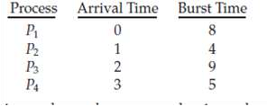

Unit II - THREADS AND CPU SCHEDULING
SCHEDULING ALGORITHMS – SHORTEST JOB FIRST SCHEDULING
If the processes arrive at the ready queue at the times shown and need the indicated bursttimes
The resulting preemptive SJF schedule is
Gantt chart:
Process P1 is started at time 0, since it is the only process in the queue.
Process P2 arrives at time 1.
The remaining time for process P1 (7 milliseconds) is larger than the time required by process P2 (4 milliseconds), so process P1 is preempted, and process P2 is scheduled.
The average waiting time for this example is [(10 − 1) + (1 − 1) + (17 − 2) + (5 − 3)]/4 = 26/4 = 6.5 milliseconds.
Nonpreemptive SJF scheduling would result in an average waiting time of 7.5 milliseconds.

Slide 38
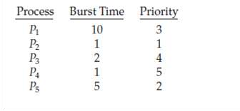

Unit II - THREADS AND CPU SCHEDULING
SCHEDULING ALGORITHMS – PRIORITY SCHEDULING
A priority number (integer) is associated with each process
The CPU is allocated to the process with the highest priority (smallest integer ≡ highest priority)
Preemptive
Nonpreemptive
SJF is priority scheduling where priority is the inverse of predicted next CPU burst time
As an example, consider the following set of processes, assumed to have arrived at time 0 in the order P1, P2, · · ·, P5, with the length of the CPU burst given in milliseconds:
The average waiting time is 8.2 milliseconds.

Slide 39
Unit II - THREADS AND CPU SCHEDULING
SCHEDULING ALGORITHMS – PRIORITY SCHEDULING
Priority scheduling can be either pre-emptive or non-preemptive.
When a process arrives at the ready queue, its priority is compared with the priority of the currently running process.
A pre-emptive priority scheduling algorithm will pre-empt the CPU if the priority of the newly arrived process is higher than the priority of the currently running process.
A nonpreemptive priority scheduling algorithm will simply put the new process at the head of the ready queue.

Slide 40
Unit II - THREADS AND CPU SCHEDULING
SCHEDULING ALGORITHMS – ROUND-ROBIN SCHEDULING
The round-robin (RR) scheduling algorithm is designed especially for timesharing systems.
It is similar to FCFS scheduling, but preemption is added to enable the system to switch between processes.
A small unit of time, called a time quantum or time slice, is defined. A time quantum is generally from 10 to 100 milliseconds in length.
The ready queue is treated as a circular queue.
The CPU scheduler goes around the ready queue, allocating the CPU to each process for a time interval of up to 1 time quantum.
The average waiting time under the RR policy is often long.

Slide 41


Unit II - THREADS AND CPU SCHEDULING
SCHEDULING ALGORITHMS – ROUND-ROBIN SCHEDULING
Consider the following set of processes that arrive at time 0, with the length of the CPU burst given in milliseconds:
Time quantum of 4 milliseconds, then process P1 gets the first 4 milliseconds. Since it requires another 20 milliseconds, it is preempted after the first time quantum, and the CPU is given to the next process in the queue, process P2. Process P2 does not need 4 milliseconds, so it quits before its time quantum expires. The CPU is then given to the next process, process P3. Once each process has received 1 time quantum, the CPU is returned to process P1 for an additional time quantum.
Let’s calculate the average waiting time for this schedule. P1 waits for 6 milliseconds (10 - 4), P2 waits for 4 milliseconds, and P3 waits for 7 milliseconds. Thus, the average waiting time is 17/3 = 5.66 milliseconds.

Slide 42
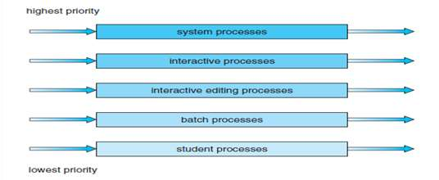
Unit II - THREADS AND CPU SCHEDULING
SCHEDULING ALGORITHMS – MULTILEVEL QUEUE SCHEDULING
A multilevel queue scheduling algorithm partitions the ready queue into several separate queues
The processes are permanently assigned to one queue, generally based on some property of the process, such as memory size, process priority, or process type.
Each queue has its own scheduling algorithm.
Example
separate queues might be used for foreground and background processes.
The foreground queue might be scheduled by an RR algorithm, while the background queue is scheduled by an FCFS algorithm.

Slide 43
Unit II - THREADS AND CPU SCHEDULING
SCHEDULING ALGORITHMS – MULTILEVEL QUEUE SCHEDULING
Example of a multilevel queue scheduling algorithm with five queues, listed below in order of priority:
System processes
Interactive processes
Interactive editing processes
Batch processes
Student processes
Each queue has absolute priority over lower-priority queues.
EXAMPLE:
No process in the batch queue, could run unless the queues for system processes, interactive processes, and interactive editing processes were all empty.
If an interactive editing process entered the ready queue while a batch process was running, the batch process would be preempted.

Slide 44
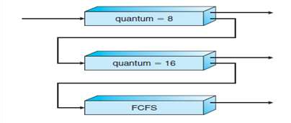
Unit II - THREADS AND CPU SCHEDULING
SCHEDULING ALGORITHMS – MULTILEVEL FEEDBACK QUEUE SCHEDULING
The multilevel feedback queue scheduling algorithm, in contrast, allows a process to move between queues.
The idea is to separate processes according to the characteristics of their CPU bursts.
If a process uses too much CPU time, it will be moved to a lower-priority queue.
This scheme leaves I/O-bound and interactive processes in the higher-priority queues.
In addition, a process that waits too long in a lower-priority queue may be moved to a higher-priority queue. This form of aging prevents starvation.
Example, consider a multilevel feedback queue scheduler with three queues, numbered from 0 to 2
The scheduler first executes all processes in queue 0.
Only when queue 0 is empty will it execute processes in queue 1.
Similarly, processes in queue 2 will be executed only if queues 0 and 1 are empty.
A process that arrives for queue 1 will preempt a process in queue 2.
A process in queue 1 will in turn be preempted

Slide 45
Unit II - THREADS AND CPU SCHEDULING
MULTIPLE PROCESSOR SCHEDULING
If multiple CPUs are available, load sharing becomes possible, but scheduling
problems become correspondingly more complex.
Approaches to Multiple-Processor Scheduling
Asymmetric Multiprocessing:
The master server.
One approach to CPU scheduling in a multiprocessor system has all scheduling decisions, I/O processing, and other system activities handled by a single processor.
The other processors execute only user code.
This asymmetric multiprocessing is simple because only one processor accesses the system data structures, reducing the need for data sharing.

Slide 46
Unit II - THREADS AND CPU SCHEDULING
MULTIPLE PROCESSOR SCHEDULING
Symmetric multiprocessing (SMP):
A second approach uses symmetric multiprocessing(SMP), where each processor is self-scheduling.
All processes may be in a common ready queue, or each processor may have its own private queue of ready processes.
Regardless, scheduling proceeds by having the scheduler for each processor examine the ready queue and select a process to execute.
Virtually all modern operating systems support SMP, including Windows, Linux, and Mac OS X.

Slide 47
Unit II - THREADS AND CPU SCHEDULING
MULTIPLE PROCESSOR SCHEDULING
Processor Affinity:
Most SMP systems try to avoid migration of processes from one processor to another and instead attempt to keep a process running on the same processor.
That is, a process has an affinity for the processor on which it is currently running.
Processor affinity takes several forms.
Soft Affinity
When an operating system has a policy of attempting to keep a process running on the same processor, but not guaranteeing that it will do so.
Hard Affinity
It is possible for a process to migrate between processors.
In contrast, some systems provide system calls that support hard affinity, thereby allowing a process to specify a subset of processors on which it may run.

Slide 48
Unit II - THREADS AND CPU SCHEDULING
MULTIPLE PROCESSOR SCHEDULING
Load Balancing:
On SMP systems, it is important to keep the workload balanced among all processors to fully utilize the benefits of having more than one processor.
Load balancing attempts to keep the workload evenly distributed across all processors in an SMP system.
There are two general approaches to load balancing:
Push migration : a specific task periodically checks the load on each processor and if it finds an imbalance, evenly distributes the load by moving (or pushing) processes from overloaded to idle or less-busy processors.
Pull migration occurs when an idle processor pulls a waiting task from a busy processor.

Slide 49

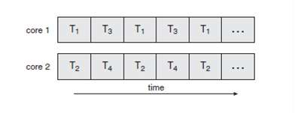
Unit II - THREADS AND CPU SCHEDULING
MULTIPLE PROCESSOR SCHEDULING
Multicore Programming:
Multiple computing cores on a single chip is called multicore or multiprocessor systems. Consider an application with four threads. On a system with a single computing core, concurrency merely means that the execution of the threads will be interleaved over time as shown below because the processing core is capable of executing only one thread at a time.
Concurrent execution on a single core system
Parallel execution on a multicore system

Slide 50
Unit II - THREADS AND CPU SCHEDULING
THREAD SCHEDULING
User-level threads are managed by a thread library, and the kernel is unaware of them
To run on a CPU, user-level threads must ulti_x0002_mately be mapped to an associated kernel-level thread, although this mapping may be indirect and may use a lightweight process (LWP)
Contention Scope
One distinction between user-level and kernel-level threads lies in how they are scheduled
On systems implementing the many-to-one and many-to-many models, the thread library schedules user level threads to run on an available LWP
This scheme is known as process contention scope (PCS), since competition for the CPU takes place among threads belonging to the same process

Slide 51
Unit II - THREADS AND CPU SCHEDULING
THREAD SCHEDULING
To decide which kernel-level thread to schedule onto a CPU, the kernel uses system-contention scope (SCS).
Competition for the CPU with SCS scheduling takes place among all threads in the system.
Systems using the one-to-one model such as Windows and Linux schedule threads using only SCS.
PCS is done according to priority— the scheduler selects the runnable thread with the highest priority to run.
User-level thread priorities are set by the programmer and are not adjusted by the thread library, although some thread libraries may allow the programmer to change the priority of a thread.
It is important to note that PCS will typically preempt the thread currently running in favour of a higher-priority thread; however, there is no guarantee of time slicing among threads of equal priority.

Slide 52
Unit II - THREADS AND CPU SCHEDULING
THREAD SCHEDULING
Pthread Scheduling
Pthreads identifies the following contention scope values:
PTHREAD SCOPE PROCESS schedules threads using PCS scheduling.
PTHREAD SCOPE SYSTEM schedules threads using SCS scheduling.
On systems implementing the many-to-many model, the PTHREAD SCOPE PROCESS policy schedules user-level threads onto available LWPs.
The number of LWPs is maintained by the thread library, perhaps using scheduler activations.
The PTHREAD SCOPE SYSTEM scheduling policy will create and bind an LWP for each user-level thread on many-to-many systems, effectively mapping threads using the one- to-one policy.

Slide 53
Unit II - THREADS AND CPU SCHEDULING
REAL-TIME CPU SCHEDULING
CPU scheduling for real-time operating systems involves special issues.
In general, there are two approaches namely soft real-time systems and hard real-time systems.
Soft real-time systems
Provide no guarantee as to when a critical real-time process will be scheduled
They guarantee only that the process will be given preference over noncritical processes
Hard real- time systems
Have stricter requirements
A task must be serviced by its deadline; service after the deadline has expired is the same as no service at all

Slide 54
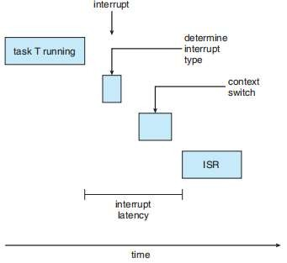
Unit II - THREADS AND CPU SCHEDULING
REAL-TIME CPU SCHEDULING
Minimizing Latency:
Event latency is the amount of time that elapses from when an event occurs to when it is serviced.
Two types of latencies affect the performance of real-time systems:
Interrupt latency
Dispatch latency
Interrupt latency refers to the period of time from the arrival of an interrupt at the CPU to the start of the routine that service the interrupt
When an interrupt occurs, the operating system must first complete the instruction it is executing and determine the type of interrupt that occurred
It must then save the state of the current process before servicing the interrupt using the specific interrupt service routine (ISR)
The total time required to perform these tasks is the interrupt latency

Slide 55
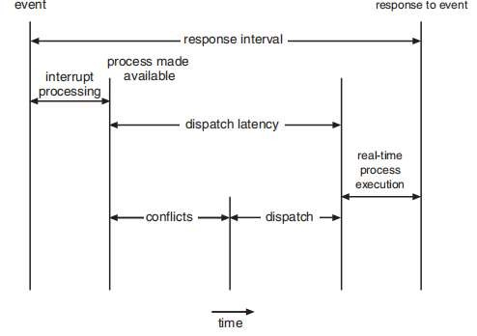
Unit II - THREADS AND CPU SCHEDULING
REAL-TIME CPU SCHEDULING
The amount of time required for the scheduling dispatcher to stop one process and start another is known as dispatch latency
Providing real-time tasks with immediate access to the CPU mandates that real-time operating systems minimize this latency as well.
The most effective technique for keeping dispatch latency low is to provide pre-emptive kernels. For hard real-time systems, dispatch latency is typically measured in several microseconds.
The conflict phase of dispatch latency has two components:
Pre-emption of any process running in the kernel
Release by low-priority processes of resources needed by a high-priority process.
Following the conflict phase, the dispatch phase schedules the high-priority process onto an available CPU.

Slide 56
Unit II - THREADS AND CPU SCHEDULING
REAL-TIME CPU SCHEDULING
The most important feature of a real-time operating system is to respond immediately to a real-time process as soon as that process requires the CPU.
As a result, the scheduler for a real-time operating system must support a priority based algorithm with pre-emption.
More important tasks are assigned higher priorities than those deemed less important. If the scheduler also supports pre-emption, a process currently running on the CPU will be pre-empted if a higher-priority process becomes available to run.
The processes are considered periodic. That is, they require the CPU at constant intervals (periods). Once a periodic process has acquired the CPU, it has a fixed processing time t, a deadline d by which it must be serviced by the CPU, and a period p.
The relationship of the processing time, the deadline, and the period can be expressed as 0 ≤ t ≤ d ≤ p. The rate of a periodic task is 1∕p.

Slide 57
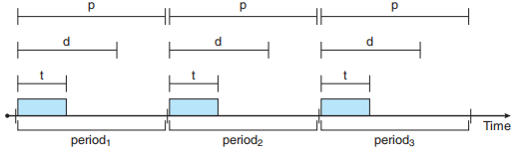
Unit II - THREADS AND CPU SCHEDULING
REAL-TIME CPU SCHEDULING
A process may have to announce its deadline requirements to the scheduler. Then, using a technique known as an admission-control algorithm, the scheduler does one of two things. It either admits the process, guaranteeing that the process will complete on time, or rejects the request as impossible if it cannot guarantee that the task will be serviced by its deadline.

Slide 58
Unit II - THREADS AND CPU SCHEDULING
REAL-TIME CPU SCHEDULING
Rate Monotonic Scheduling
The rate-monotonic scheduling algorithm schedules periodic tasks using a static priority policy with pre-emption.
If a lower-priority process is running and a higher-priority process becomes available to run, it will pre-empt the lower-priority process.
Upon entering the system, each periodic task is assigned a priority inversely based on its period.
The shorter the period, the higher the priority;
The longer the period, the lower the priority.
The rationale behind this policy is to assign a higher priority to tasks that require the CPU more often. Furthermore, rate-monotonic scheduling assumes that the processing time of a periodic process is the same for each CPU burst.
That is, every time a process acquires the CPU, the duration of its CPU burst is the same.

Slide 59
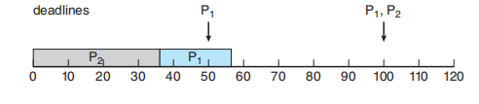
Unit II - THREADS AND CPU SCHEDULING
REAL-TIME CPU SCHEDULING
Rate Monotonic Scheduling
Let’s consider two processes, P1 and P2. The periods for P1 and P2 are 50 and 100, respectively— that is, p1 = 50 and p2 = 100. The processing times are t1 = 20 for P1 and t2 = 35 for P2. The deadline for each process requires that it complete its CPU burst by the start of its next period.
One must first analyse whether it is possible to schedule these tasks so that
each meets its deadlines.
The CPU utilization of a process Pi as the ratio of its burst to its period—ti∕pi— the CPU utilization of P1 is 20∕50 = 0.40 and that of P2 is 35∕100 = 0.35, for a total CPU utilization of 75 percent. Therefore, it seems we can schedule these tasks in such a way that both meet their deadlines and still leave the CPU with available cycles.
The worst-case CPU utilization for scheduling N processes is
N(2^{1∕N} − 1)

Slide 60
Unit II - THREADS AND CPU SCHEDULING
REAL-TIME CPU SCHEDULING
Earliest-Deadline-First Scheduling
Earliest-deadline-firs (EDF) scheduling assigns priorities dynamically according to deadline.
The earlier the deadline, the higher the priority; the later the deadline, the lower the priority.
Under the EDF policy, when a process becomes runnable, it must announce its deadline requirements to the system.
Priorities may have to be adjusted to reflect the deadline of the newly runnable process. Note how this differs from rate-monotonic scheduling, where priorities are fixed.

Slide 61
Unit II - THREADS AND CPU SCHEDULING
REAL-TIME CPU SCHEDULING
Consider P1 has values of p1 = 50 and t1 = 25 and that P2 has values of p2
= 80 and t2 = 35.
Process P1 has the earliest deadline, so its initial priority is higher than that of process P2.
Process P2 begins running at the end of the CPU burst for P1.
P2 now has a higher priority than P1 because its next deadline (at time 80) is earlier than that of P1 (at time 100). Thus, both P1 and P2 meet their first deadlines.
Process P1 again begins running at time 60 and completes its second CPU burst at time 85, also meeting its
second deadline at time 100.
P2 begins running at this point, only to be pre-empted by P1 at the start of its next period at time 100. P2 is pre-empted because P1 has an earlier deadline (time 150) than P2 (time 160).
At time 125, P1 completes its CPU burst
and P2 resumes execution, finishing at time 145 and meeting its deadline as well. The system is idle until time 150, when P1 is scheduled to run once again.
Unlike the rate-monotonic algorithm, EDF scheduling does not require that processes be periodic, nor must a process require a constant amount of CPU time per burst. The only requirement is that a process announce its deadline to the scheduler when

